Slide 1
Metro Tickets Reservation System
Submitted By : Omar Alaa
Omar Zakaria
Abdelrahman Mohamed

Slide 2
APP description
Metro Tickets Reservation System is a desktop application designed to smooth the process of booking Tickets.
The user can also view the metro map, get detailed information about each metro line, and view subscription guidance.

Slide 3
APP description
First the passenger needs to register in the app, then he can login using the registered information.
In the login process, the APP determines whether the input info belongs to an admin or a passenger.

Slide 4
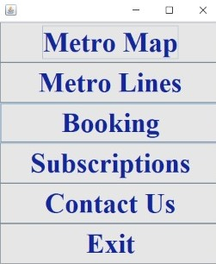
APP description

Slide 5
APP description
For passengers, they will be directed to the app home page where they will be able to choose between many options.
Passengers can view metro map, stations names of each line, view subscription guidance, submit complaints / suggestions, or book tickets.

Slide 6
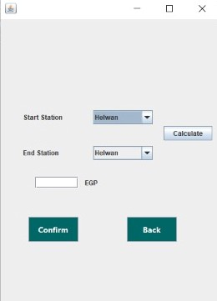
APP description

Slide 7
APP description
To book a ticket, the app takes the start, end stations then print price and color of the ticket.
The passenger can buy the ticket using credit card, but first he will be asked for more information (CVV, Number, End date)

Slide 8
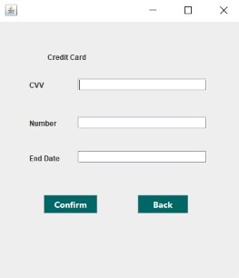
APP description

Slide 9
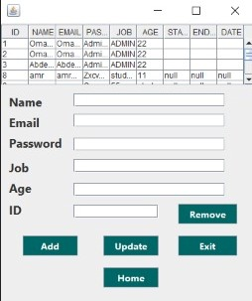
APP description

Slide 10
APP description
For Admin, he will be directed to the admin page, in which he has more options.
The Admin can Add / remove / update any account and view all the records.

Slide 11
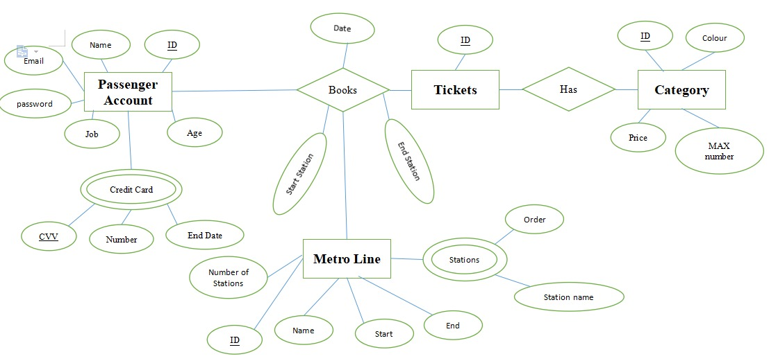
ERD

Slide 12
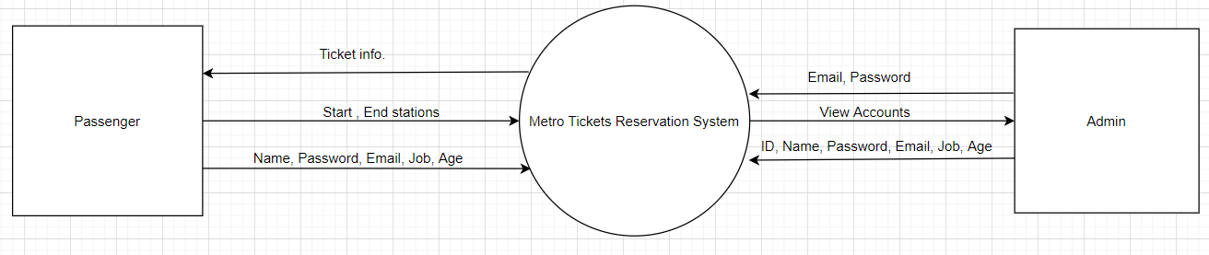
DFD
LEVEL ZERO

Slide 13
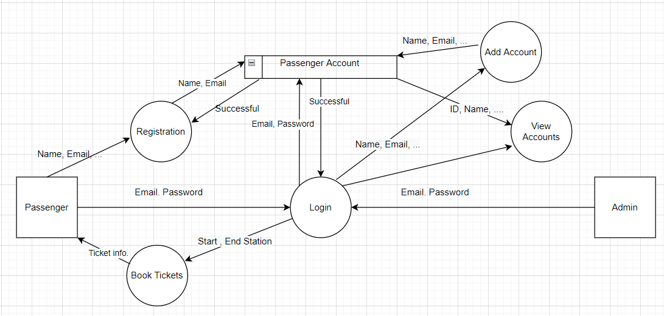
DFD
LEVEL ONE

Slide 14
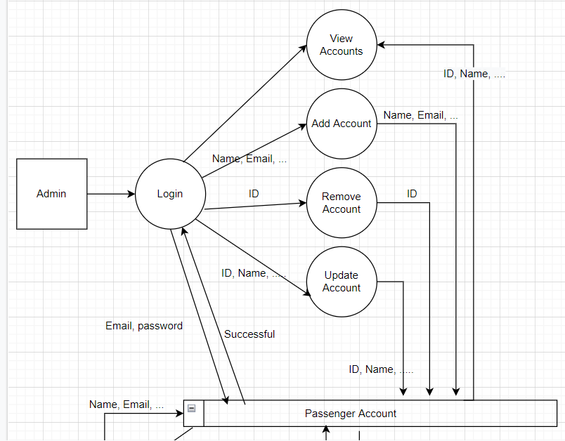
DFD
LEVEL TWO : Part 1

Slide 15
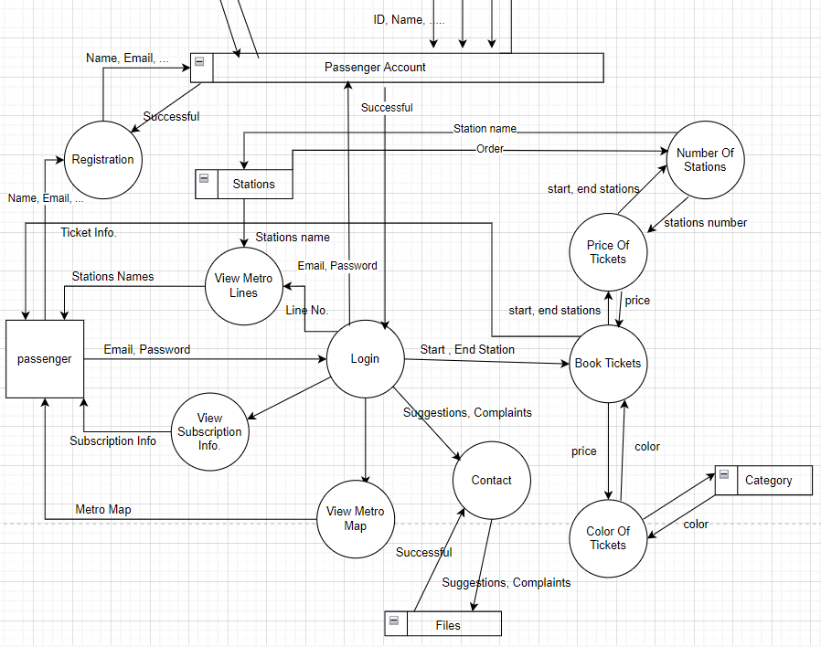
DFD
LEVEL TWO : part 2

Slide 16
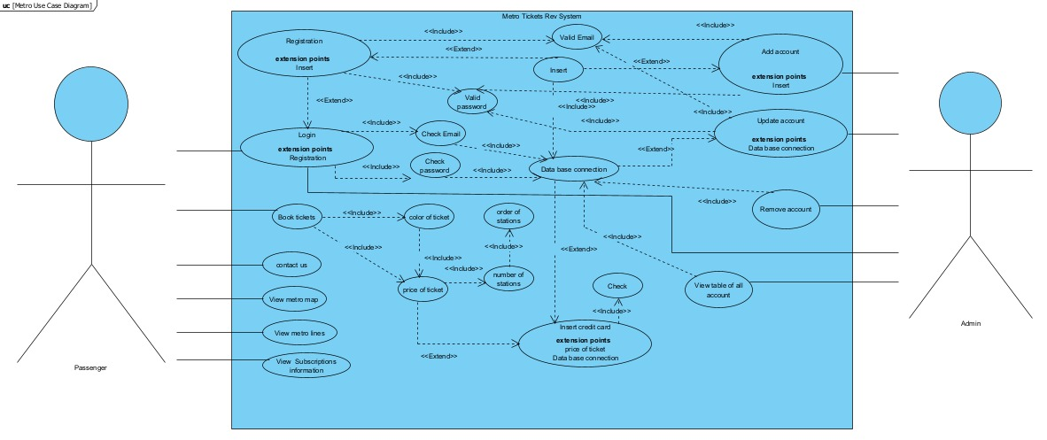
Use Case Diagram

Slide 17
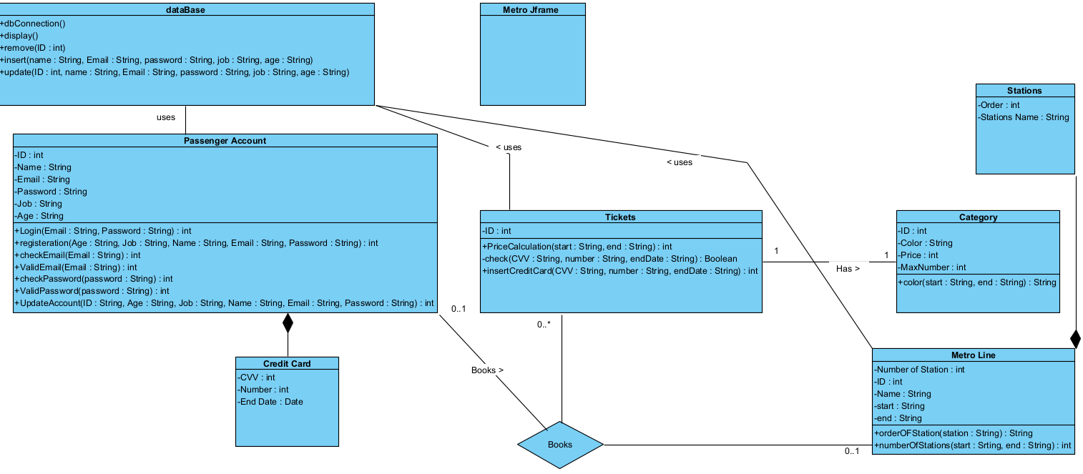
Class Diagram

Slide 18
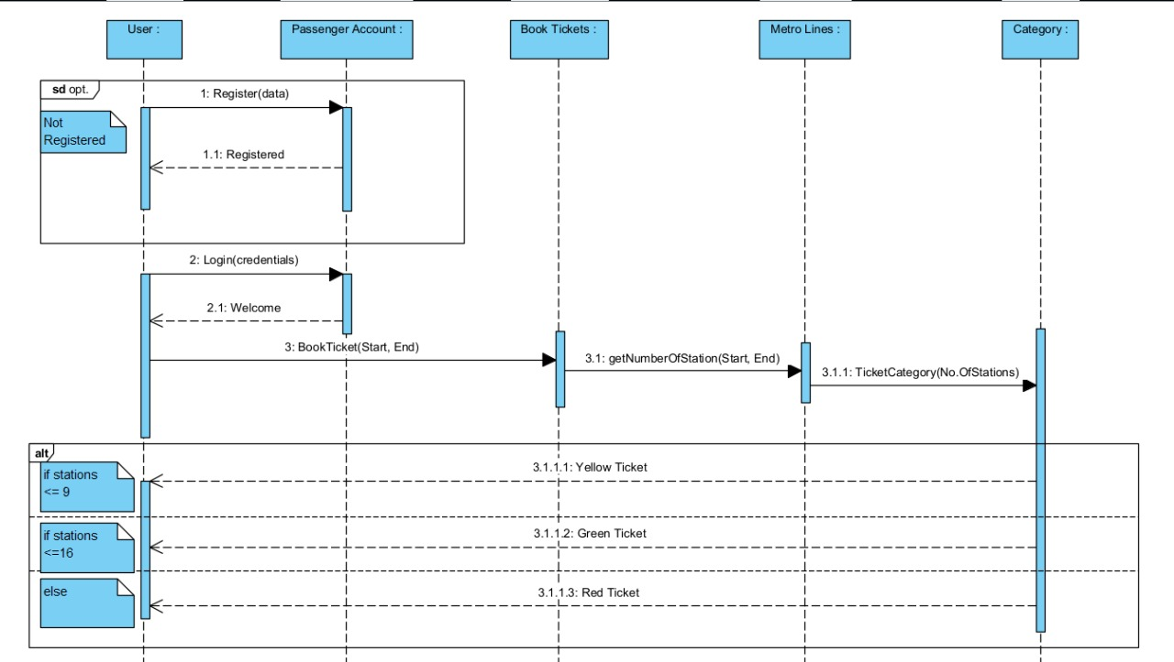
Sequential Diagram

